Slide 1
Adham Ashraf Saeed
Assignment 3 (Power BI)

Slide 2
Load the provided dataset
Data Source

Slide 3
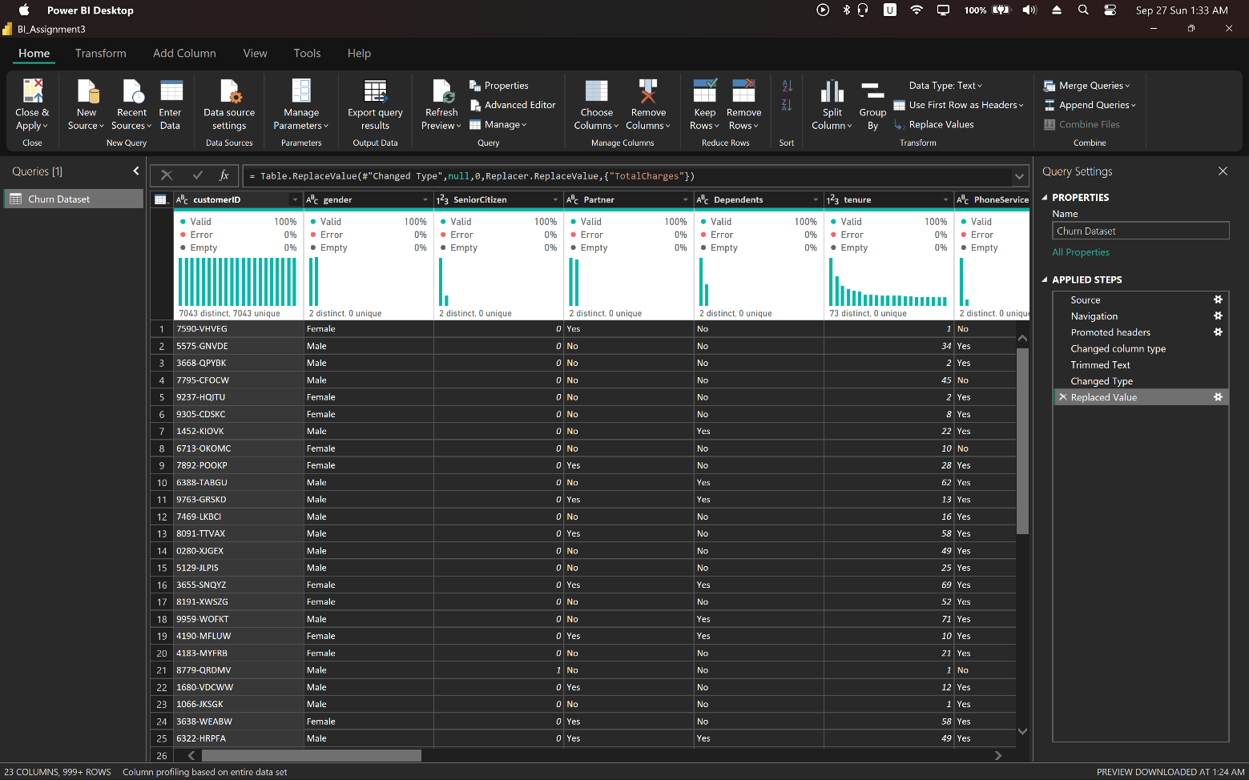
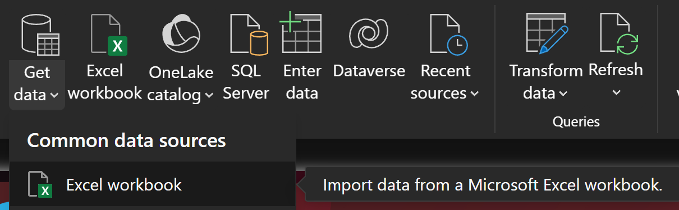
Import Data

Slide 4
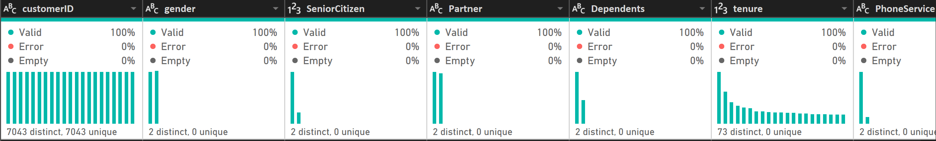
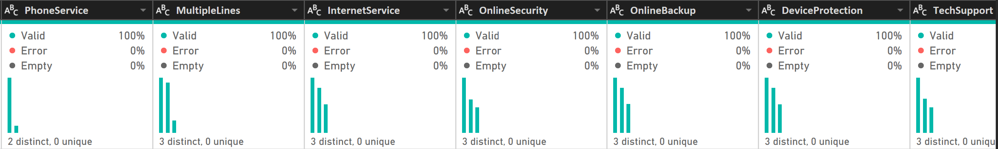
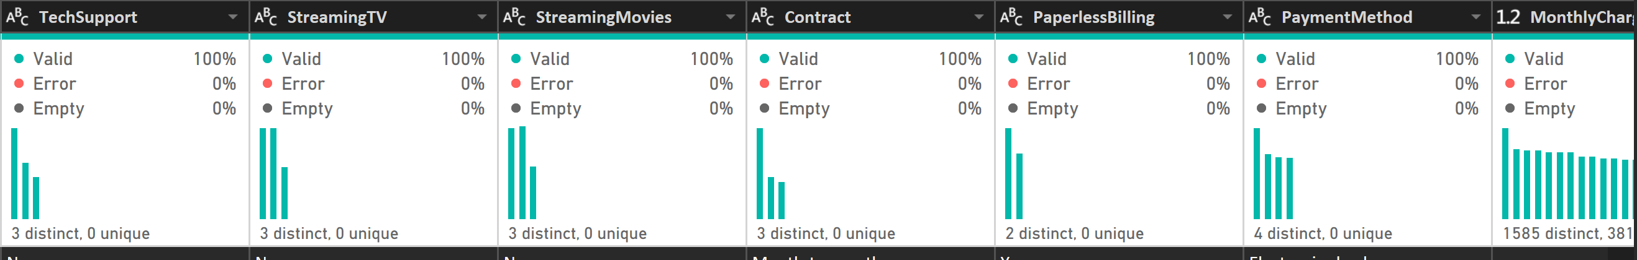
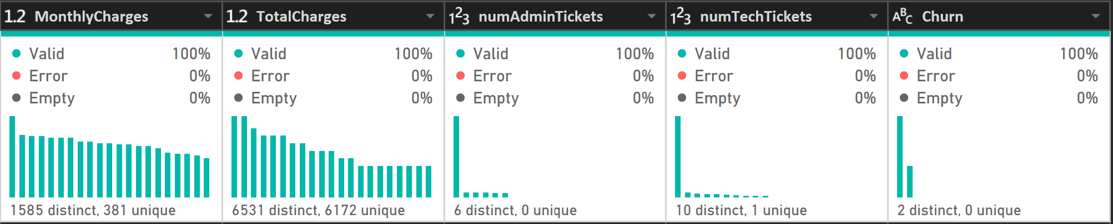
Clean Data

Slide 5
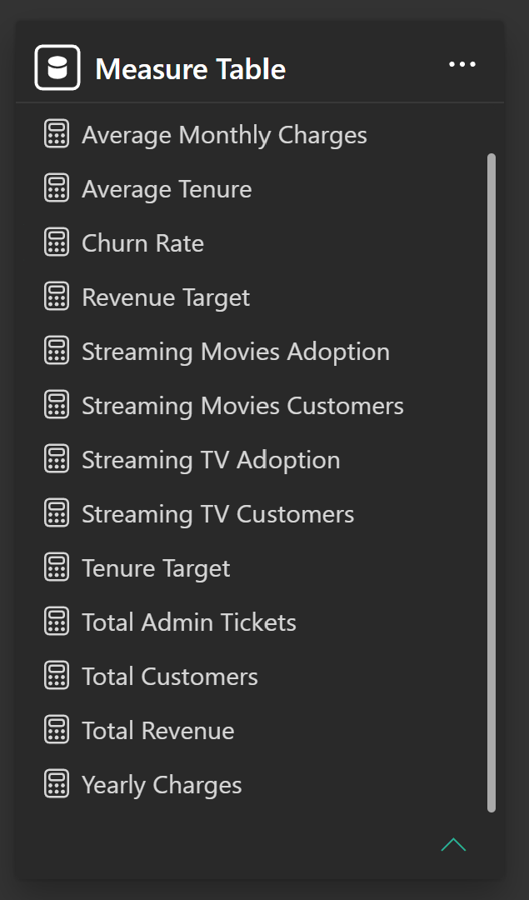
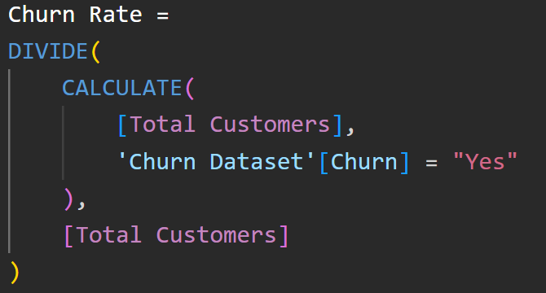
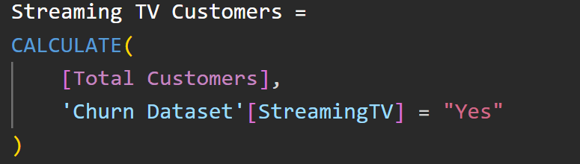
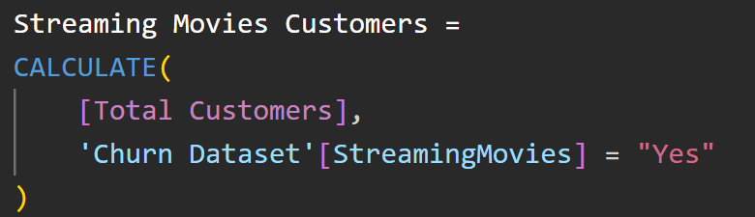
Create Measures

Slide 6

Figma Design Dashboard

Slide 7
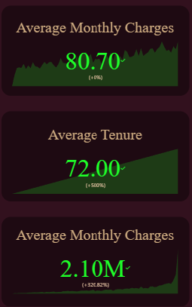
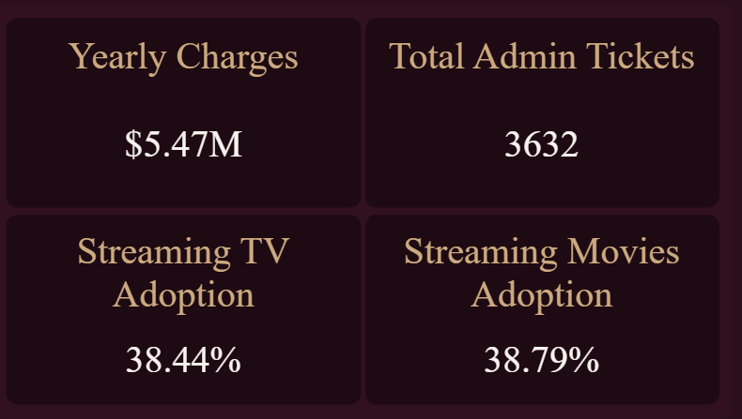
Key Performance Indicators (KPIs)
Admin Tickets: Monitoring administrative or billing-related inquiries.
Yearly Charges: Total revenue generated on an annual basis.
Streaming TV & Streaming Movie: Adoption rates for entertainment services.

Slide 8
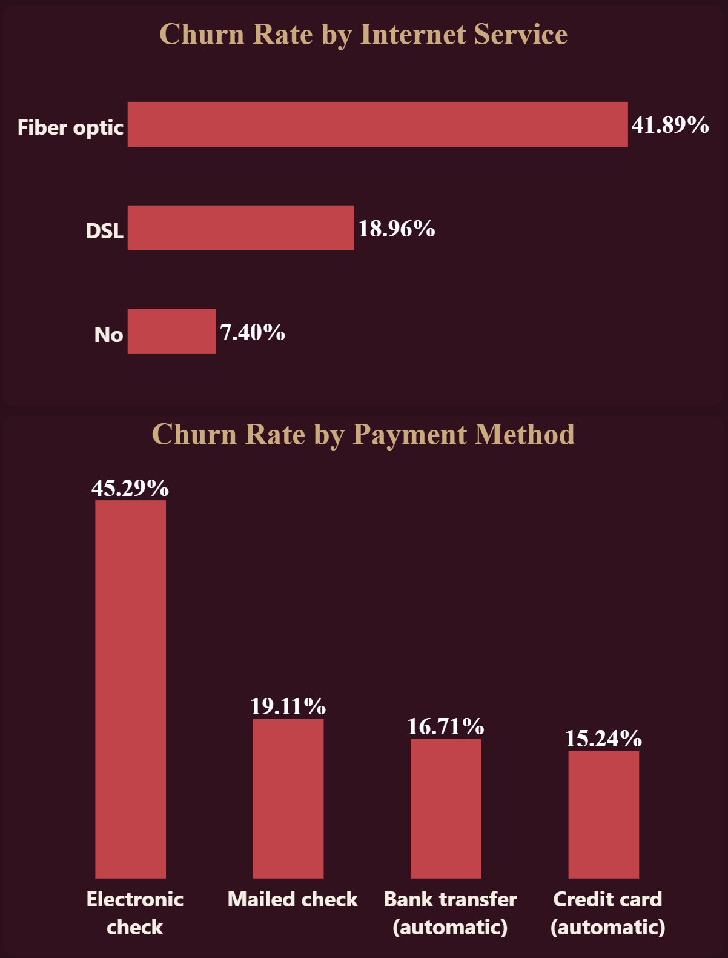
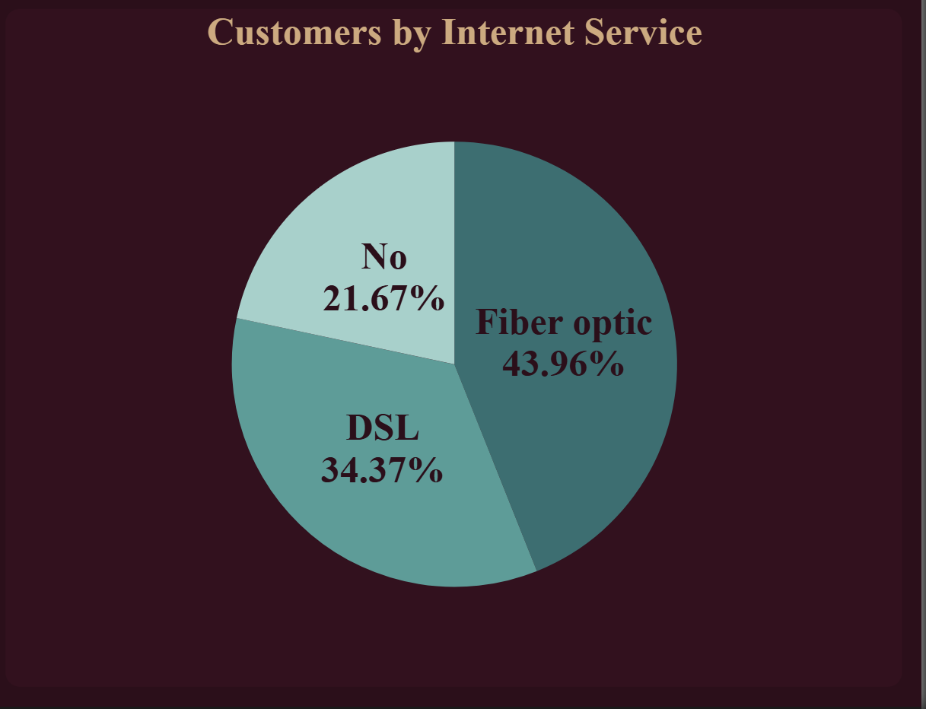
Charts
Churn Rate by Type of Internal Service: A bar chart identifying which services have the highest turnover.
Churn Rate by Payment Method: A bar chart displaying which payment behaviors correlate with leaving.
Customers by Internal Service: A pie chart showing the distribution of the user base across services.

Slide 9
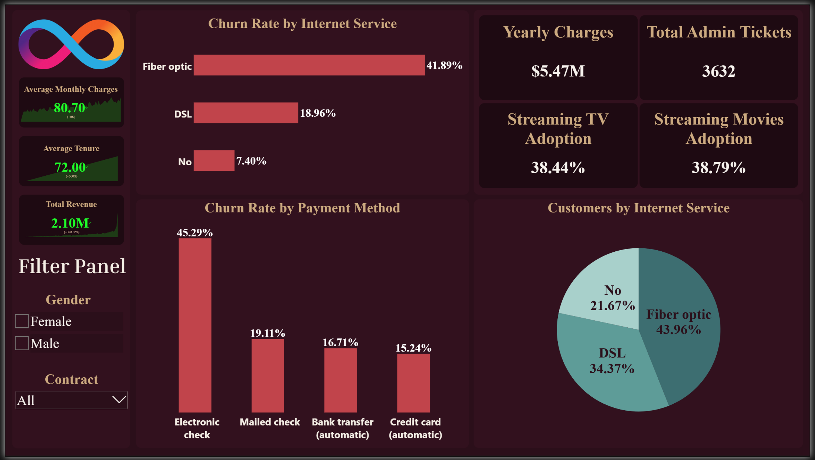
Final Dashboard

